Slide 1

Data Structures and Abstractions with Java™
5th Edition
Module 22 – Internet Networking

Slide 2
Module 22
Main topics:
The Internet Protocol
Sockets
A client program
A server program
Application Protocols
Designing Client/Server Programs (Simple Bank)
Threads
Internet Application Protocols
HTTP
URL Connections

Slide 3
The Internet Protocol
Internet
A worldwide collection of networks, routing equipment, and computers
Uses a common set of protocols to define how the parties will interact with each other
IP: Internet Protocol
Developed to enable different local area networks to communicate with each other
Has become the basis for connecting computers around the world together over the Internet

Slide 4
Data Transmission
Consists of sending/receiving streams of zeros and ones along the network connection
Two types of information:
Application data
The information one computer wants to send to another
Network protocol data
Describes how to reach the intended computer
Describes how to check for errors in the transmission

Slide 5
Sending Data From A to B Across the Internet
A is your home computer
It is connected to an Internet Service Provider (ISP)
The ISP is connected to an Internet Access Point
B is on an local area network at XYZ Computers
XYZ has its own Internet Access Point
The Internet Access Points are connected by a complex collection of pathways (the Internet)
Over these pathways a message sent from one access point can eventually reach any access point

Slide 6
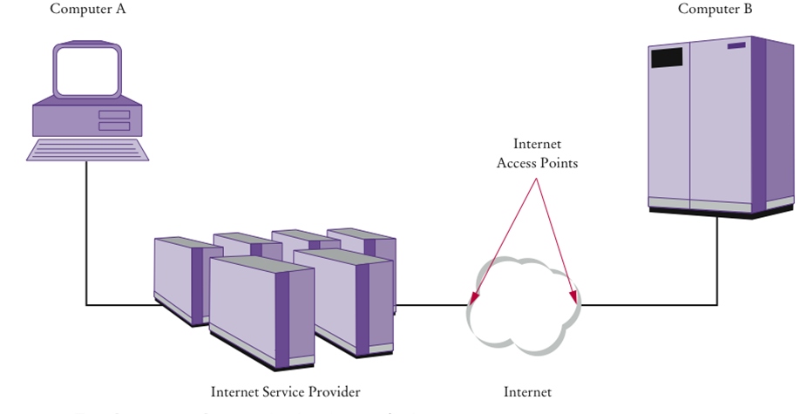
Two Computers Communicating Across the Internet

Slide 7
Destination Address
Data must be marked with a destination address
In IP, addresses are denoted by a sequence of four numbers
Each is one byte (a number between 0 and 255)
For example 130.65.86.66
To be able to accommodate more devices, IP addresses will be extended to sixteen bytes
To send data to B, A needs to know B’s Internet address
A includes that address in the protocol portion when sending the data

Slide 8
Domain Naming Service
In addition to an IP address, computers can have an easy-to-remember domain name
For example, horstmann.com
Domain Naming Service (DNS): translates from domain name to IP address
When A wants to request data from a domain name:
It asks the DNS for the numeric Internet Address
It includes the numeric address with the request for data

Slide 9
Packets
IP breaks large chunks of data up into more manageable packets
Each packet is delivered separately
Each packet in a larger transmission may be sent by a different route
Packets are numbered
The recipient reassembles the data

Slide 10
Transmission Control Protocol
Internet Protocol (IP) does not notify the sender if data is lost or garbled
This is the job of a higher level protocol Transmission Control Protocol (TCP)
The most commonly used Internet services use TCP with IP (TCP/IP)
The TCP’s job is to:
Attempt to deliver the data
Try again if there are failures
Notify the sender whether or not the attempt was successful

Slide 11
Port Numbers
One computer can offer multiple services over the Internet
For example, both a web server program and an email server program
When data are sent to that computer, they need to indicate which program is to receive the data
IP uses port numbers for this
A port number is an integer between 0 and 65,535
The sending program must know the port number of the receiving program
This number is included in the transmitted data
Web servers usually use port 80
POP mail servers usually use port 110

Slide 12
Contents of TCP Packet
The Internet address of the recipient
The port number of the recipient
Internet address of the sender
The port number of the sender

Slide 13
Something to consider:
Why do some streaming media services not use TCP?
TCP is reliable but somewhat slow. When sending sounds or images in real time, it is acceptable if a small amount of the data is lost. But there is no point in transmitting data that is late.

Slide 14
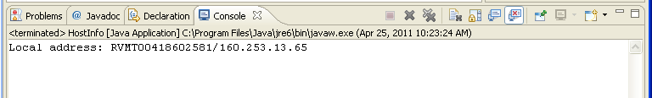
To find your local IP address
import java.net.InetAddress;
import java.net.UnknownHostException;
public class HostInfo {
public static void main (String args[]) {
try {
System.out.println("Local address: " +
InetAddress.getLocalHost());
}
catch (UnknownHostException e) {
System.out.println("Local address unknown");
}
}
}

Slide 15
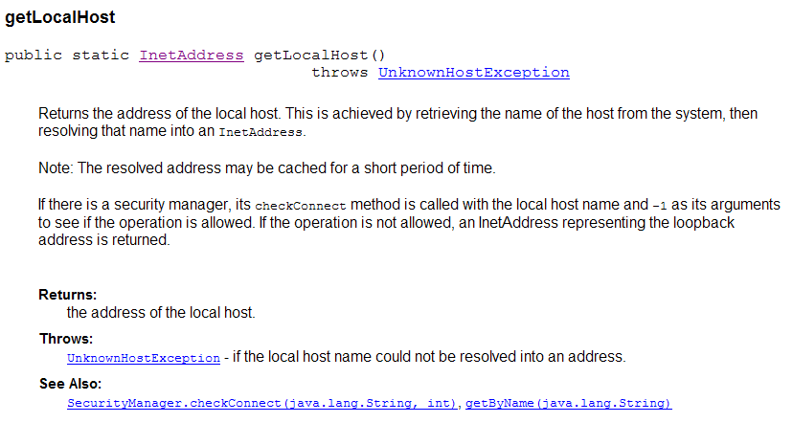

Slide 16
Sockets
A socket is an object that encapsulates a TCP/IP connection
There is a socket on both ends of a connection
Create a socket in a Java program:
Socket s = new Socket(hostname, portnumber);
If it can’t find the host, the Socket constructor throws an UnknownHostException

Slide 17
Sockets – Input and Output Streams
Use the input and output streams attached to the socket to communicate with the other endpoint
Obtain the input and output streams:
InputStream instream = s.getInputStream(); OutputStream outstream = s.getOutputStream();
When you send data to outstream, the socket forwards them to the server
The socket catches the server’s response and you can read it through instream
When you are done communicating with the server, close the socket:
s.close();

Slide 18
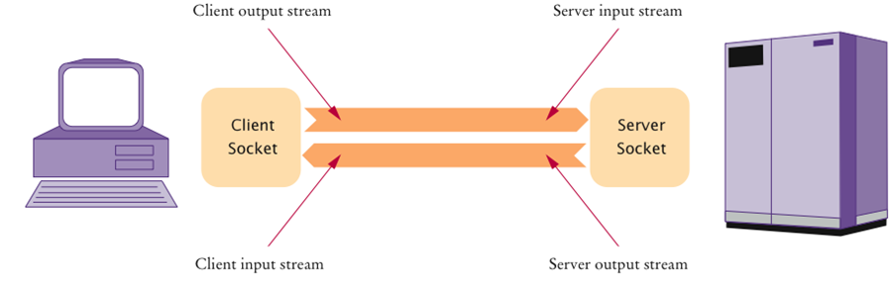
Client and Server Sockets

Slide 19
Scanners and Writers
InputStream and OutputStream send and receive bytes
To send and receive text, use a scanner and a writer:
Scanner in = new Scanner(instream); PrintWriter out = new PrintWriter(outstream);
A PrintWriter buffers the characters and only sends when the buffer is full
Buffering increases performance
When sending a command, if you want the whole command to be sent now
Flush the buffer manually:
out.print(command); out.flush();

Slide 20
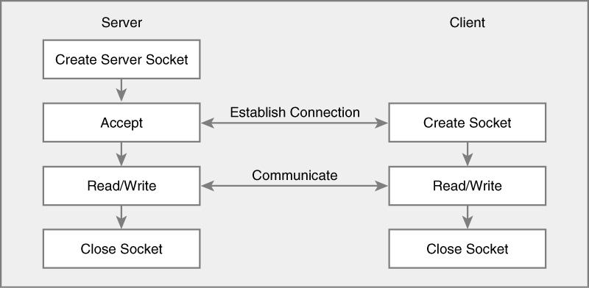
Socket and ServerSocket
The Socket and ServerSocket classes provide reliable stream-
oriented delivery using TCP.
When establishing a connection, one machine actively establishes
the connection (client), whereas the other machine takes a passive
role and waits for a connection request (server).

Slide 21
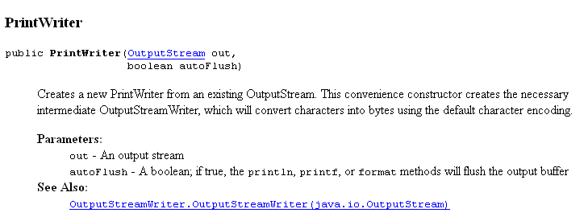
The Server
import java.io.*;
import java.net.*;
import java.util.Date;
class DayTimeServer {
public static void main(String[] args) {
try {
ServerSocket listen = new ServerSocket(0);
System.out.println("I am listening on port: " + listen.getLocalPort());
while (true) {
Socket client = listen.accept();
PrintWriter out = new PrintWriter(client.getOutputStream(),true);
out.println(new Date());
out.close();
client.close();
}
}
catch (IOException e) {
System.err.println(e.getMessage());
}
}
}
Uses next available port

Slide 22
The Client
import java.io.*;
import java.net.*;
import java.util.Scanner;
public class DayTimeClient {
public static void main(String args[]) {
try {
Scanner scan = new Scanner(System.in);
System.out.println("Which port? ");
int port = scan.nextInt();
Socket sock = new Socket("localhost", port);
Scanner in = new Scanner(sock.getInputStream()));
System.out.println(in.nextLine());
in.close();
sock.close();
}
catch (UnknownHostException e) {
System.err.println("DayTimeClient: no such host");
}
catch (IOException e) {
System.err.println(e.getMessage());
}
}
}

Slide 23
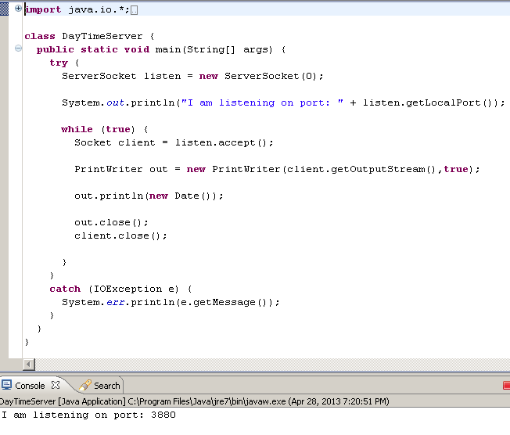
First start the
Server program

Slide 24
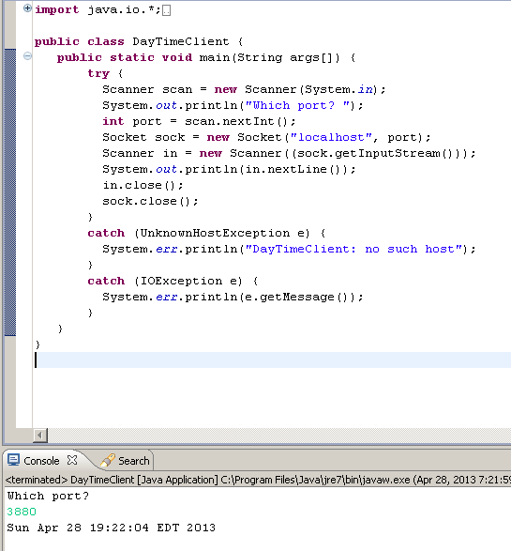
Then start the
Client program

Slide 25
Using a specific port
import java.io.*;
import java.net.*;
import java.util.Date;
class DayTimeServer {
public static void main(String[] args) {
try {
ServerSocket listen = new ServerSocket(8800);
// System.out.println("I am listening on port: " + listen.getLocalPort());
while (true) {
Socket client = listen.accept();
PrintWriter out = new PrintWriter(client.getOutputStream(),true);
out.println(new Date());
out.close();
client.close();
}
}
catch (IOException e) {
System.err.println(e.getMessage());
}
}
}

Slide 26
Using a specific port
import java.io.*;
import java.net.*;
import java.util.Scanner;
public class DayTimeClient {
public static void main(String args[]) {
try {
Scanner scan = new Scanner(System.in);
// System.out.println("Which port? ");
// int port = scan.nextInt();
Socket sock = new Socket("localhost", 8800);
Scanner in = new Scanner(sock.getInputStream()));
System.out.println(in.readLine());
in.close();
sock.close();
}
catch (UnknownHostException e) {
System.err.println("DayTimeClient: no such host");
}
catch (IOException e) {
System.err.println(e.getMessage());
}
}
}

Slide 27
The Server
import java.io.*;
import java.net.*;
import java.util.Date;
import java.util.Scanner;
class MessageServer {
public static void main(String[] args) {
try {
ServerSocket server = new ServerSocket(8800);
System.out.println("Waiting for clients to connect . . .");
while (true) {
Socket client = server.accept();
System.out.println("Client connected.");
Scanner in = new Scanner(client.getInputStream());
PrintWriter out = new PrintWriter(client.getOutputStream());
String whichMessageString = in.nextLine();
int whichMessage = Integer.parseInt(whichMessageString);
System.out.println("whichMessage " + whichMessage);
switch(whichMessage)
{
case 1:out.println("You have chosen the first option\n");
out.flush();
break;
case 2: out.println("You have chosen the second option\n");
out.flush();
break;
case 3 : out.println("You have chosen the third option\n");
out.flush();
break;
default : out.println("Invalid choice\n");
out.flush();
}
out.flush();
out.close();
client.close();
}
}
catch (IOException e) {
System.err.println(e.getMessage());
}
}
}

Slide 28
The Client
import java.io.*;
import java.net.*;
import java.util.Scanner;
public class MessageClient {
public static void main(String args[]) {
try {
Scanner scan = new Scanner(System.in);
Socket client = new Socket("localhost", 8800);
InputStream instream = client.getInputStream();
OutputStream outstream = client.getOutputStream();
Scanner in = new Scanner(instream);
PrintWriter out = new PrintWriter(outstream);
System.out.println("1. First\n2. Second\n3. Third\nWhich option? ");
int option = scan.nextInt();
out.print("" + option+ "\n");
out.flush();
String response = in.nextLine();
System.out.println(response);
in.close();
client.close();
}
catch (UnknownHostException e) {
System.err.println("No such host");
}
catch (IOException e) {
System.err.println(e.getMessage());
}
}
}
“localhost” – machine on the loopback interface. Client and
Server will be same machine
Also IP address 127.0.0.1

Slide 29
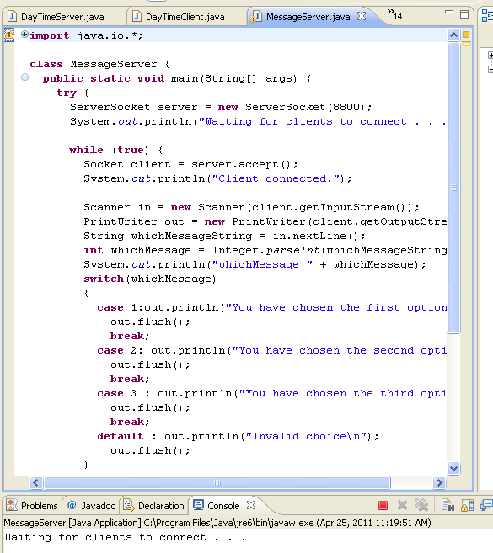

Slide 30
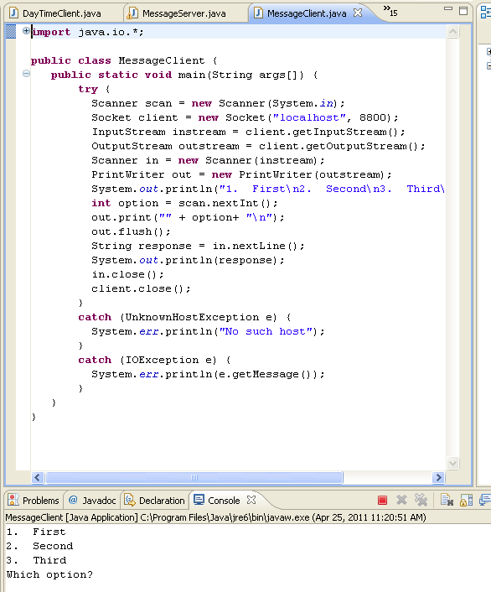

Slide 31
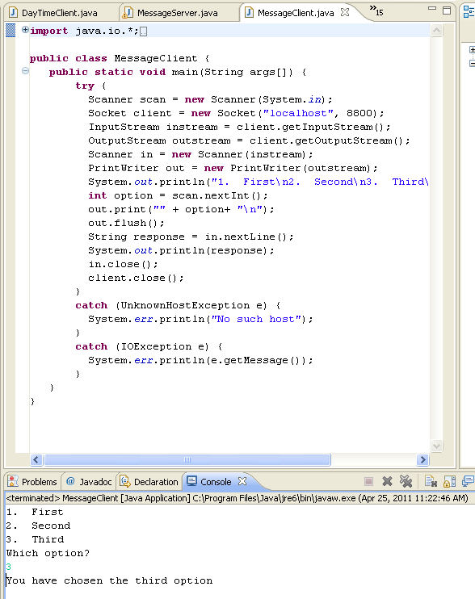
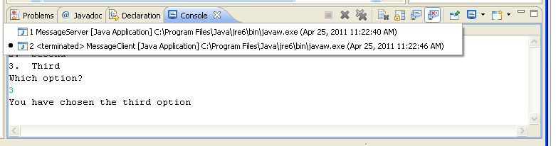
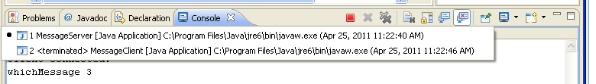
Allows you to toggle
Between the consoles
Running or terminated

Slide 32
To find IP address from domain name
Results from running HostInfo.java: RVMT00418602581DT/160.253.13.65
import java.net.*;
class Resolver {
public static void main(String[] args) {
for(int i=0;i<args.length; i++)
{
try {
System.out.print(args[i] + ": ");
System.out.println(InetAddress.getByName(args[i]));
} catch (UnknownHostException e) {
System.out.println("Unknown host");
}
}
}
}
To run in eclipse: Run -> Run configurations, type in name from
getHostLocal Host as an argument.
Result:
RVMT00418602581DT: RVMT00418602581DT/160.253.13.65
montgomerycollege.edu: montgomerycollege.edu/216.127.146.200

Slide 33
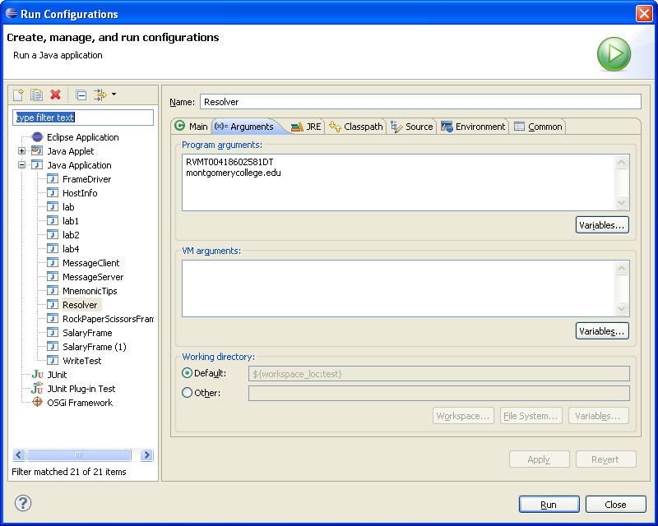
To run in eclipse: Run -> Run configurations
Result:
RVMT00418602581DT: RVMT00418602581DT/160.253.13.65
montgomerycollege.edu: montgomerycollege.edu/216.127.146.200

Slide 34
Application level protocol
Sample server program: enables clients to manage bank accounts in a bank
When you develop a server application, you need some application-level protocol
The client can use this protocol to interact with the server
A simple bank access protocol is described on the next slide

Slide 35
Application Level Protocols
TCP/IP mechanism establishes an Internet connection between two ports on two computers
Each Internet application has its own application protocol
This application protocol describes how data for that application are transmitted
Example of application protocol
Client Request | Server Response | Description
BALANCE n | n and the balance | Get the balance of account n
DEPOSIT n a | n and the new balance | Deposit amount a into account n
WITHDRAW n a | n and the new balance | Withdraw amount a from account n
QUIT | None | Quit the connection

Slide 36
The Server
The server waits for clients to connect on a certain port
We choose 8888
To listen for incoming connections, use a server socket
To construct a server socket, provide the port number:
ServerSocket server = new ServerSocket(8888);
Use the accept method to wait for client connection and obtain a socket:
Socket s = server.accept(); BankService service = new BankService(s, bank);

Slide 37
The Server – BankService
BankService carries out the service
Implements the Runnable interface
Its run method will be executed in each thread that serves a client connection
run gets a scanner and writer from the socket, then executes:
public void run() {
. . . while (true) { if (!in.hasNext()) return; String command = in.next(); if (command.equals("QUIT")) return; executeCommand(command); } }

Slide 38
The Server – executeCommand
Processes a single command
If the command is DEPOSIT, it carries out the deposit
int account = in.nextInt(); double amount = in.nextDouble(); bank.deposit(account, amount);
WITHDRAW is handled in the same way
After each command, the account number and new balance are sent to the client:
out.println(account + " " + bank.getBalance(account));

Slide 39
The Server
Then returns to the run method if the client closed the connection or the command equals QUIT
Then run closes the socket and exits
How can we support multiple simultaneous clients?
Spawn a new thread whenever a client connects
Each thread is responsible for serving one client

Slide 40
The Server – Threads
BankService implements Runnable; so, it can start a thread using start() (of class Thread)
The thread dies when the client quits or disconnects and the run method exits
In the meantime, BankServer loops back to accept the next connection
while (true) { Socket s = server.accept(); BankService service = new BankService(s, bank); Thread t = new Thread(service); t.start(); }
The server program never stops
When you are done running the server, you need to kill it

Slide 41
BankAccount
BankService
2
print
read
read
BankClient
2
balance(acct, amt)
deposit(acct, amt)
withdraw(acct, amt)
print
deposit(amt)
withdraw(amt)
getBalance(amt)
creates Thread
reference to socket
reference to Bank
BankServer
accept
Bank
creates
accept
creates Thread
reference to socket
reference to Bank
BankClient
1
print
balance(acct, amt)
deposit(acct, amt)
withdraw(acct,amt)
read
BankService1
read
print

Slide 42
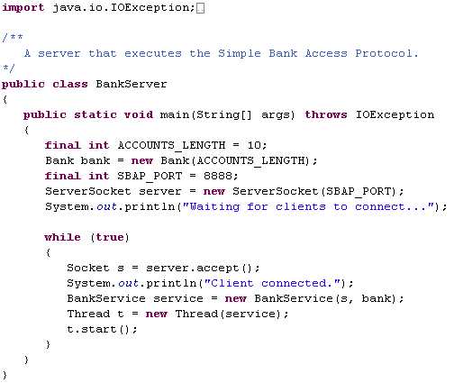

Slide 43
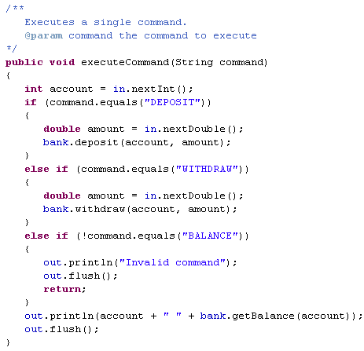
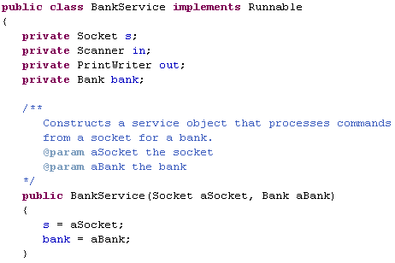
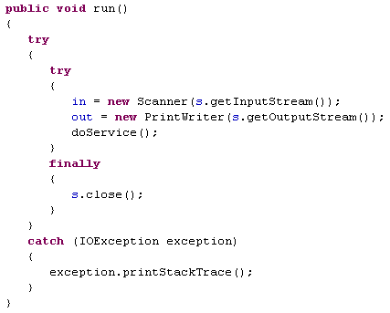
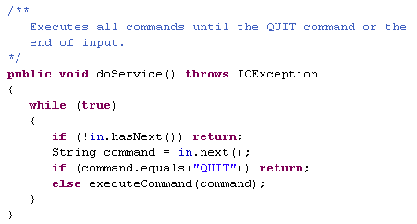

Slide 44
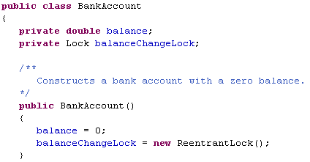
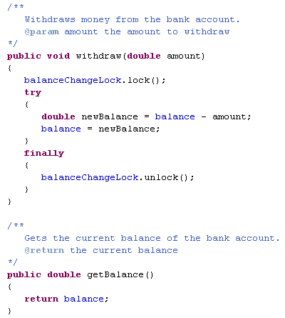
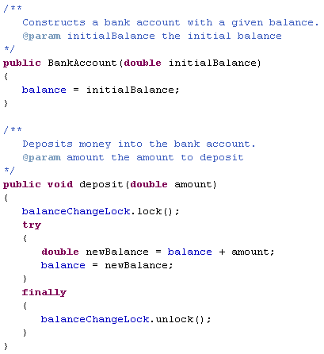

Slide 45
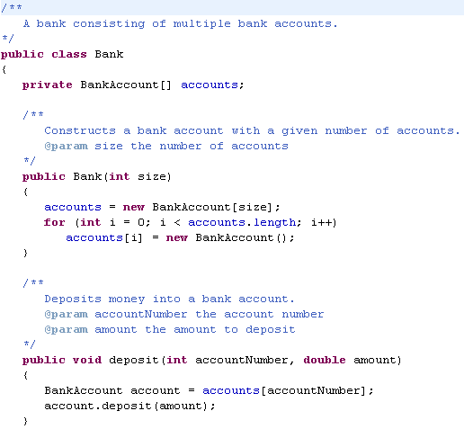
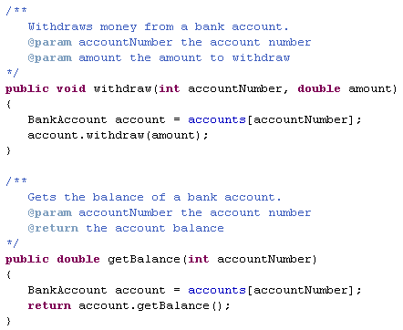

Slide 46
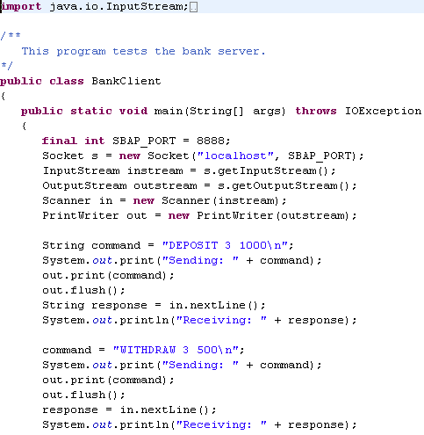
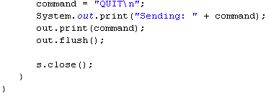

Slide 47
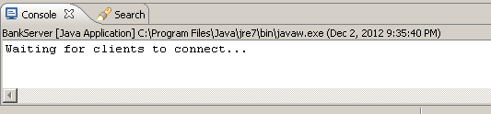
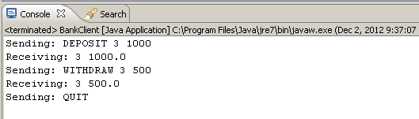
Start the BankServer
Start the BankClient

Slide 48
Internet Application Level Protocols
HTTP is one of many application protocols in use on the Internet
Another commonly used protocol is the Post Office Protocol (POP)
POP is used to download received messages from e-mail servers
To send messages, you use another protocol: Simple Mail Transfer Protocol (SMTP)

Slide 49
HTTP
Do not confuse HTTP with HTML
HTML is a document format that describes the structure of a document
HTTP is a protocol that describes the command set for web server requests
Web browsers
Know how to display HTML documents
And how to issue HTTP commands
Web servers
Know nothing about HTML
Merely understand HTTP and know how to fetch the requested items

Slide 50
HTTP Commands
Command | Meaning
GET | Return the requested item
HEAD | Request only the header information of an item
OPTIONS | Request communications options of an item
POST | Supply input to a server-side command and return the result
PUT | Store an Item on the server
DELETE | Delete an item on the server
TRACE | Trace server communication

Slide 51
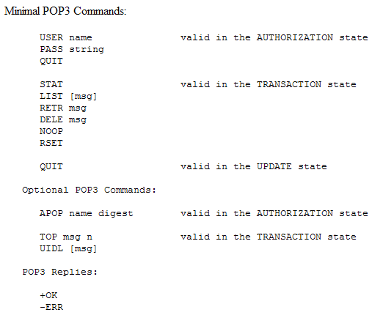

Slide 52
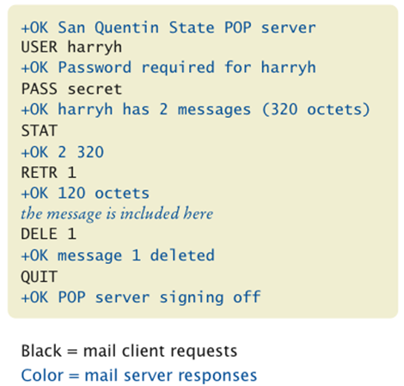
A Sample POP Session

Slide 53
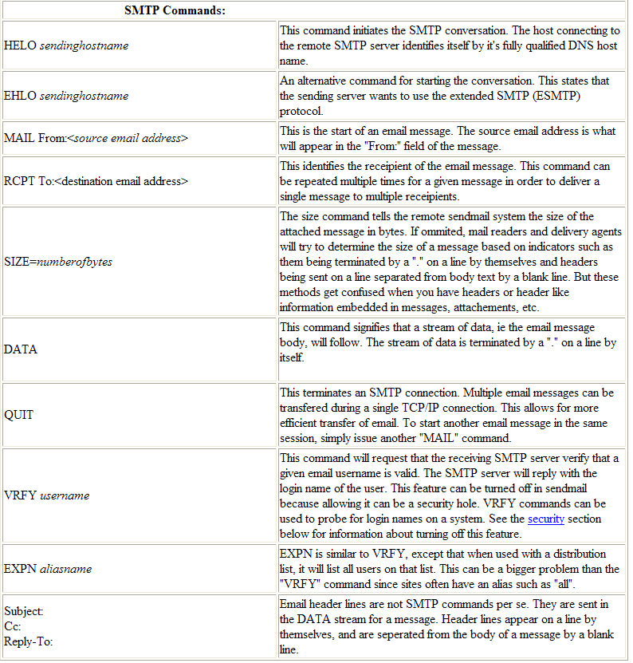

Slide 54
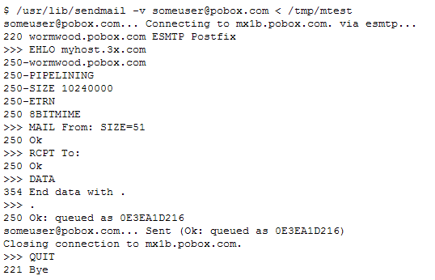
Send email to someuser@pobox.com from myhost.3x.com

Slide 55
URL Connections
URLConnection class
Provides convenient support for HTTP
Can also handle FTP (file transfer protocol)
Takes care of socket connection for you
Makes it easy to communicate with a web server without giving HTTP commands

Slide 56
URL Connections
Construct a URL object from a URL starting with the http or ftp prefix:
URL u = new URL("http://smith.com/index.html");
Use the URL's openConnection method to get the URLConnection:
URLConnection connection = u.openConnection();
Call the getInputStream method to obtain an input stream:
InputStream instream = connection.getInputStream();
You can turn the stream into a scanner in the usual way

Slide 57
HTTP Commands
command request properties blank line
HTTP command
Such as GET item HTTP/1.0
request properties
Such as If-Modified-Since: date
blank line
Separates the command and its request properties from the input data

Slide 58
URLConnection Class
Has methods to set request properties:
connection.setIfModifiedSince(date);
Set the request properties before calling getInputStream
The URLConnection class sends all the request properties that are set to the web server

Slide 59
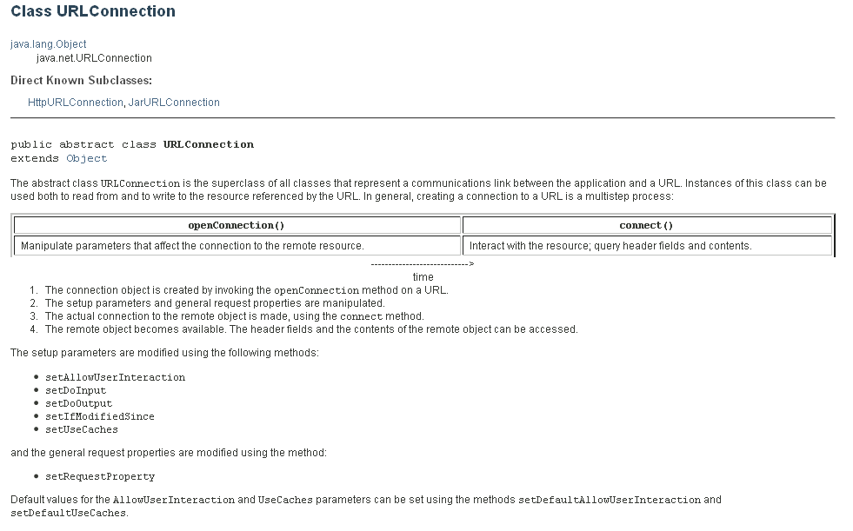

Slide 60
Server Response
Server response:
status line containing response code
response parameters
blank line
For example:
HTTP/1.1 200 OK
Date: Tue, 24 Aug 2010 00:15:48 GMT
Server: Apache/1.3.3 (Unix)
Last-Modified: Sat, 26 Jun 2010 20:53:38 GMT
Content-Length: 4813
Content-Type: text/html
blank line
requested data
{

Slide 61
Retrieve Other Response Information from URLConnection
Content length:
int length = connection.getContentLength();
Content type:
String type = connection.getContentType();

Slide 62
Server Response
Normally, you don’t see the response code, in this case: 200 OK
You may have run across bad links and see a page that contains response code 404 Not Found

Slide 63
Retrieving Response Code and Message
Cast the URLConnection object to the HttpURLConnection subclass
Get the response code with getResponseCode
Get the response message with getResponseMessage:
HttpURLConnection httpConnection = (HttpURLConnection) connection; int code = httpConnection.getResponseCode(); // e.g., 404 String message = httpConnection.getResponseMessage(); // e.g., "Not found"

Slide 64
